Slide 1
Case Competition for Fundraising Project
Team Members: Xiang Cao
Haitao Liu
Liwen Tong
Yang Yu

Slide 2
Content
Introduction
Methods Comparison
Results & Interpretation
Data Overview
Notes:
Introduction, Data Overview , Method, Result & Interpretation,

Slide 3
Introduction
Data Description
Feature Categories
Goal
More than 100 variables
Over 90,000 observations
General Information of Donators
Neighborhood Information
Donation History
Prediction
Segmentation(Marketing Recommendation)

Slide 4
Data Overview
Data cleaning
Convert Date of First Gift into a new numerical variable
Convert Zip Code
e.g. 8901 $→107$
e.g. 8901 →107
convert 5% negative into positive
add zero back: e.g. 1002 $→$ 01002
add zero back: e.g. 1002 → 01002
Neighborhood Code
create a new factor for 2.5% of missing Neighborhood Code
Gender
Convert A & C into the dominated level Female
Notes:
22% Missing value prediction, visualize the conversion

Slide 5
Data Overview
Data cleaning
Prediction Missing Values of Income and Age
1
1
3.9
n=74k 100%
62
n=72k 100%
Y
AvgHousInc <436
N
Y
# Child>=0.5
N
1
64
n=60k 84%
2
3
3.4
n=51k 69%
5
n=23k 31%
Y
MonFirstGift<94
N
Home < 0.5
Home < 0.5
1
1
Y
N
Y
N
60
n=34k 47%
69
n=27k 37%
Income >=2.5
Income>=2.5
5
7
Y
N
Y
N
3.8
N=34k 46%
5.2
n=18k 25%
1
58
n=25k 35%
Age > 65
AvgHousInc <562
Y
N
Y
N
Y
AvgAge <36
N
4
8
9
6
11
12
2
24
25
13
14
15
2.7
n=18k 24%
3.2
n=14k 19%
4.2
n=20k 27%
4
n=4.2k 6%
4.9
n=10k 14%
5.7
n=8k 11%
50
n=11k 16%
55
n=15k 21%
62
n=9.7k 14%
65
n=8.7k 12%
67
n=18k 25%
74
n=8k 12%
Regression Tree for Income
Regression Tree for Age
Notes:
22% Missing value prediction, Income Age, Scaling and Centering all the variables

Slide 6
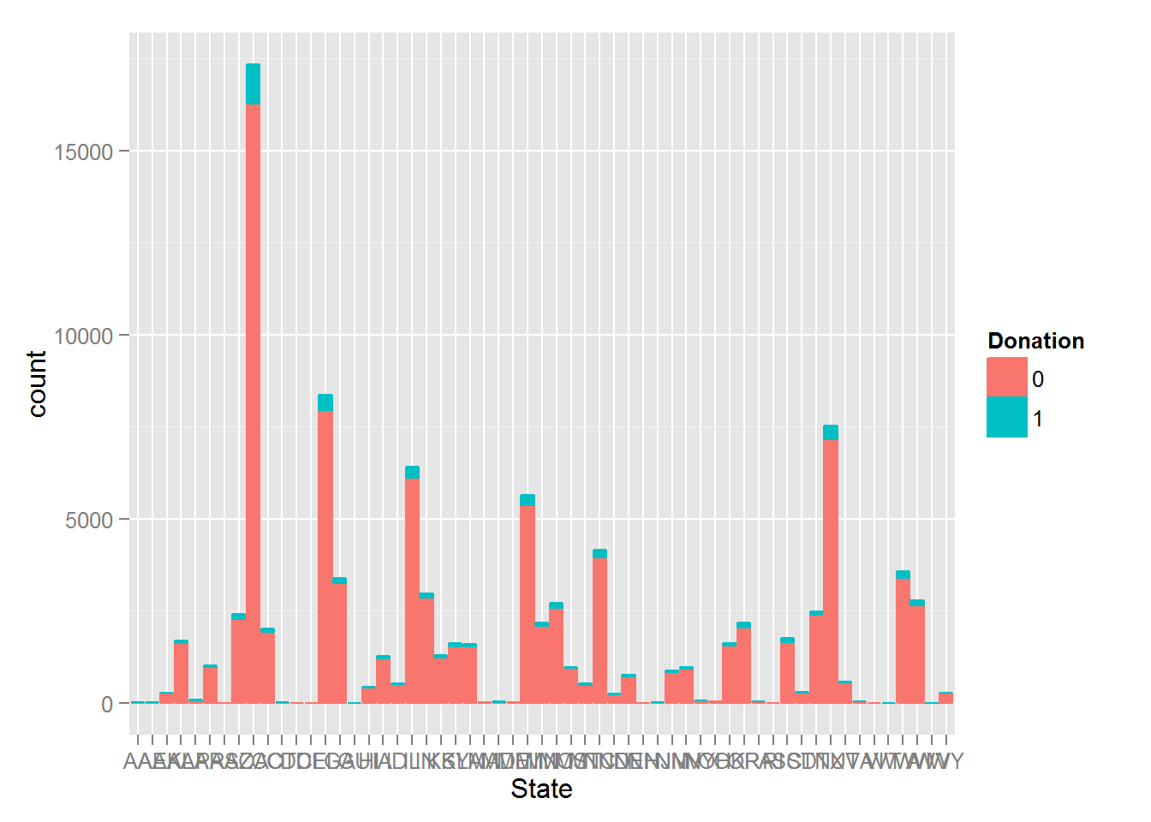
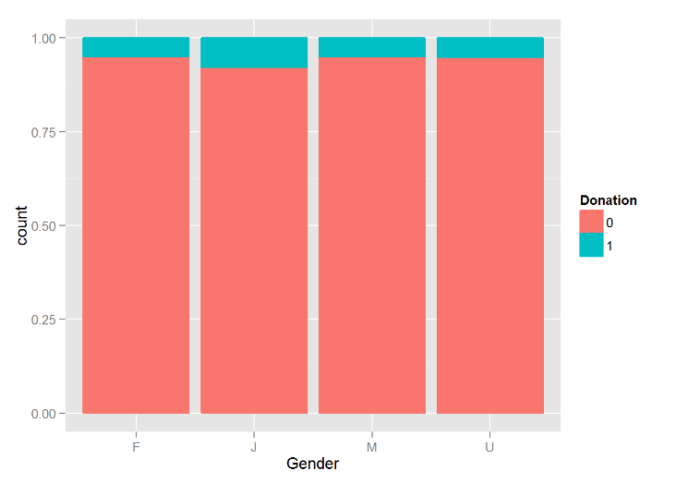
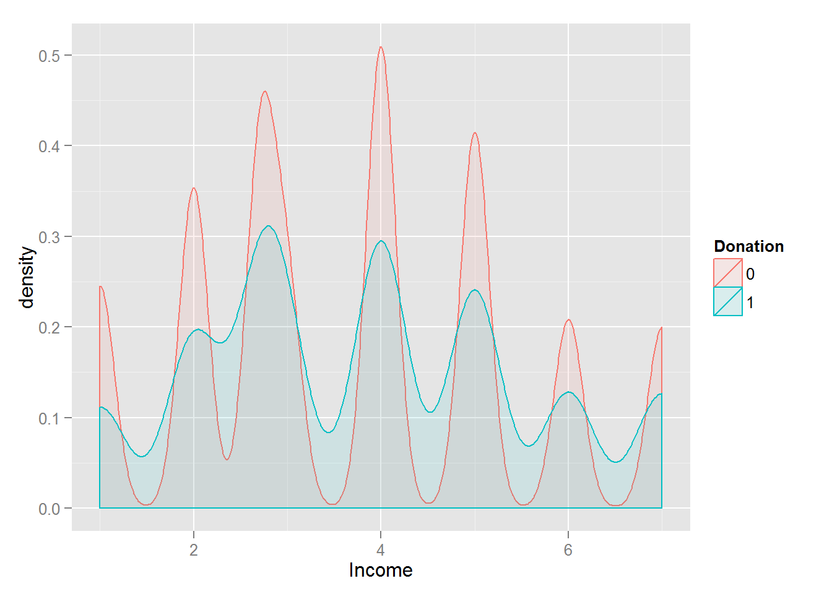
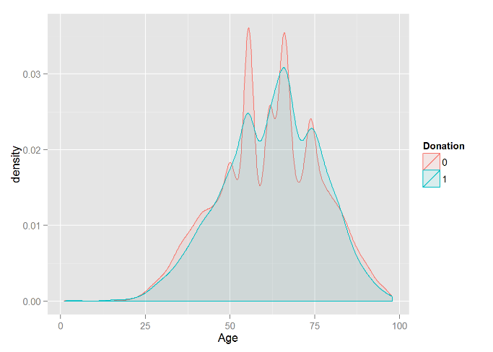
Descriptive statistics
Data Overview
Notes:
2 pages of EDA

Slide 7
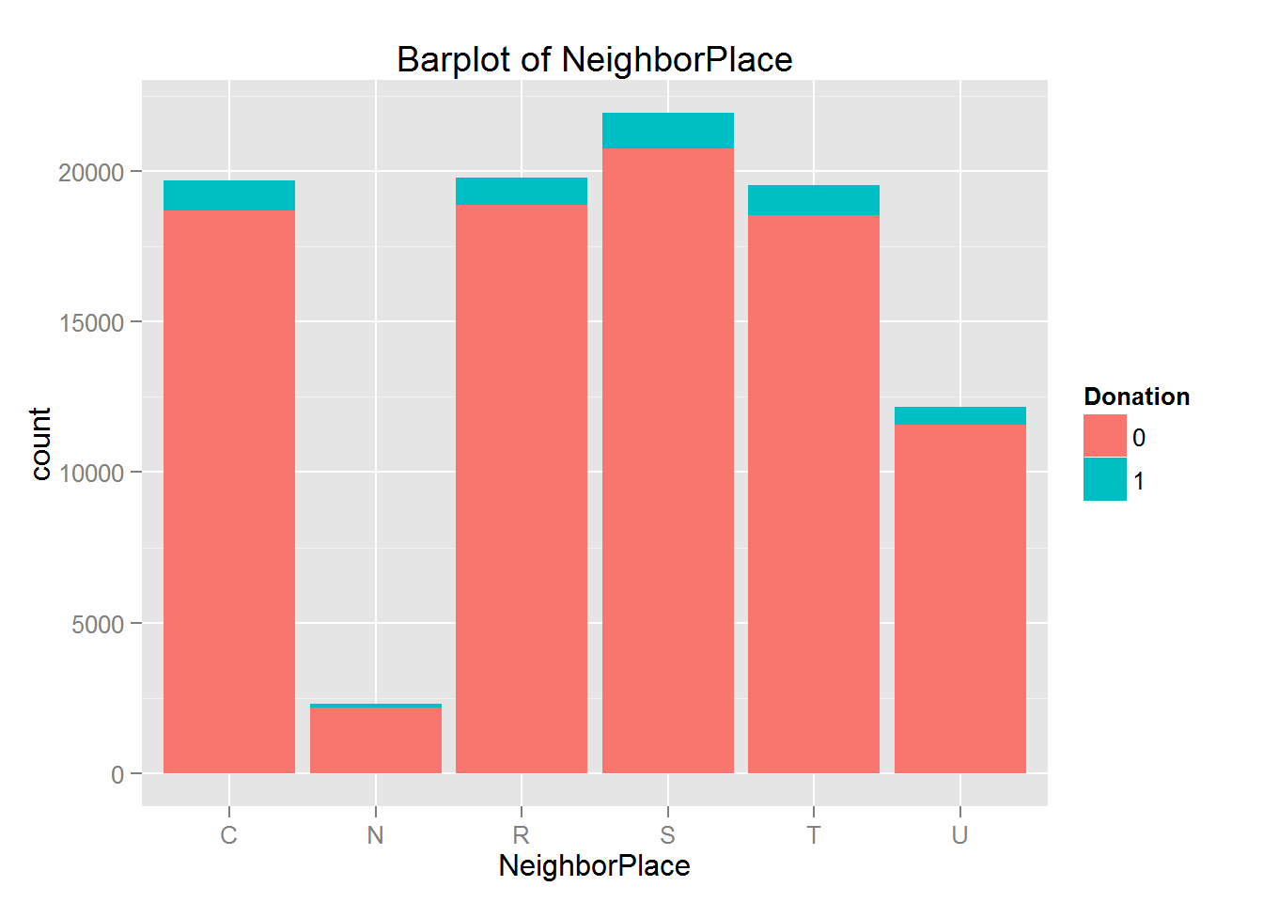
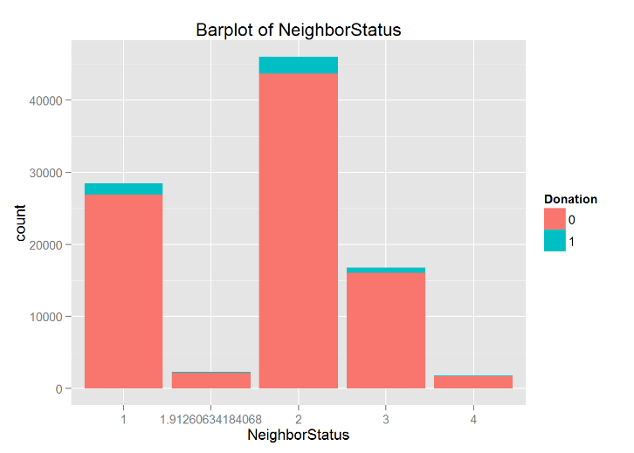
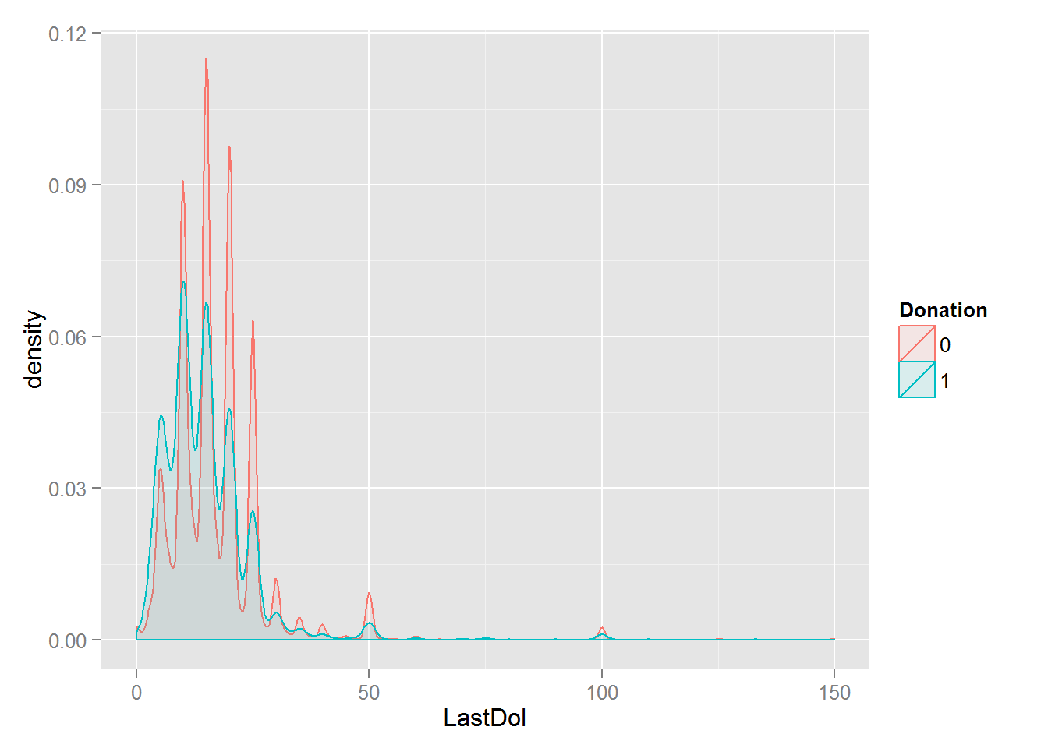
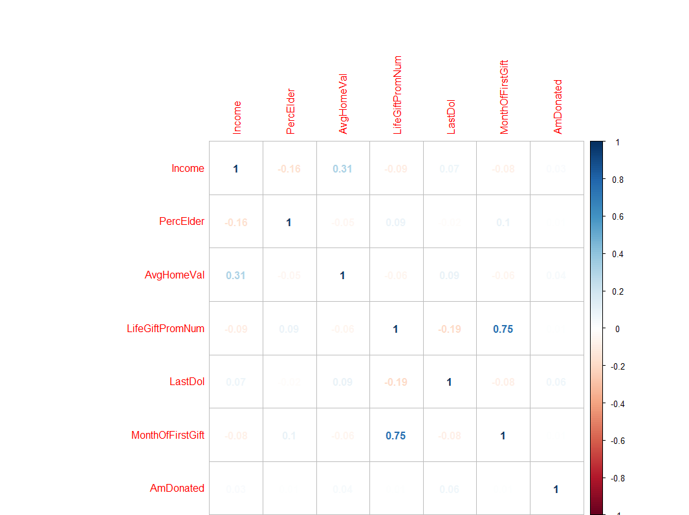
Descriptive statistics
Data Overview

Slide 8
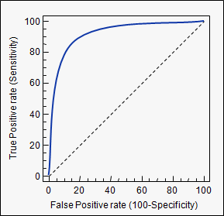
Dealing with Rare Event: Metrics
Data Overview
Lift & F1 Score
AUC/ROC Curve
 | Predicted Negative | Predicted Positive
Actual Negative | TN | FP
Actual Positive | FN | TP
Precision
Sensitivity
Notes:
Don’t forget to mention traditional Metric: error rate.

Slide 9
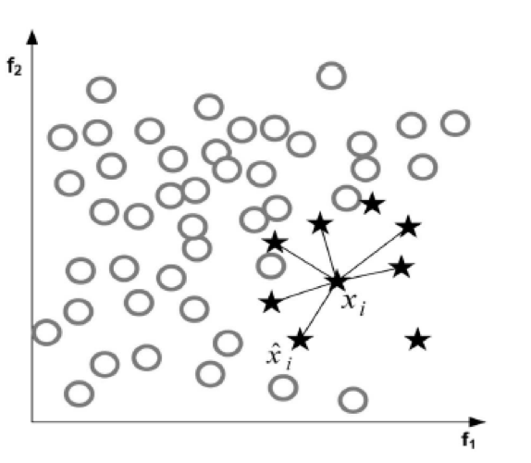

Data Overview
Dealing with Rare Event: Sampling
Cons for Over-sampling:
Just duplication and no additional information
Overfitting
Cons for Under-sampling:
Risk of removing some representative observations
Synesthetic Minority Over-Sampling Technique (SMOTE) & Under-sampling
$x_{new}=x+rand(0,1$)*($\hat{x}$-x)
Notes:
讲述over 和under不足，结合决定用smote sampling， 讲解我们如何用smote抽样

Slide 10
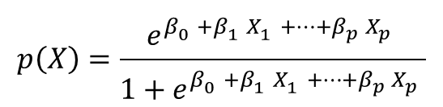
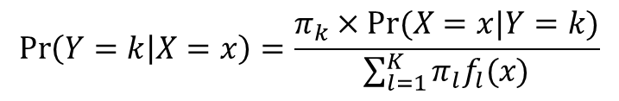
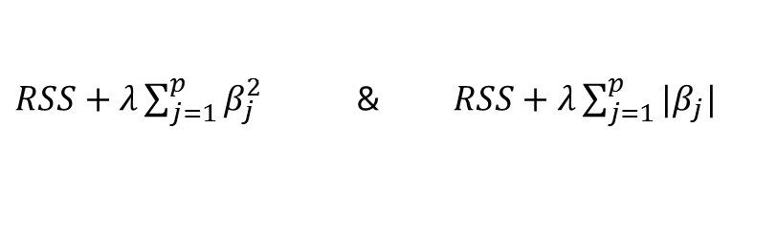
Methods Comparison
KNN
Classify a given test observation by identifying its K near neighbors
Naïve Bayes
$$\operatorname{Pr}\left(Y=k | X=x\right)=\frac{π_{k}×Pr⁡(X=x|Y=k)}{\sum_{l=1}^{K}{π_{l}f_{l}(x)}}$$
Logistic
$$p\left(X\right)=\frac{e^{β_{0}^{}+β_{1}^{}X_{1}^{}+…+β_{p}^{}X_{p}^{}}}{1+e^{β_{0}^{}+β_{1}^{}X_{1}^{}+…+β_{p}^{}X_{p}^{}}}$$
Ridge & Lasso
$RSS+λ\sum_{j=1}^{p}{β_{j}^{2}}$ & $RSS+λ\sum_{j=1}^{p}{|β_{j}|}$
Random Forest
A tree-based classifier using a random subset of predictor at each split

Slide 11
Methods Comparison
 | Naïve Bayes | KNN(k=7)
AUC | 0.5502 | 0.4885
F | 0.1095
LIFT | 1.2112
Notes:
表格美化

Slide 12
Methods Comparison
Ridge Elastic Net Lasso

Slide 13

Methods Comparison
New classification for Top 350
Top 350 Donated = “ 1 ”
Donated = “1”
60% Train Data
Other Donated = “ 0 ”
Non-Donated = “0”
 | Lasso | Regression | Overlaps 1 | Random Forest | Overlaps 2
Top 50 | 2 | 2 | 2 | 0 | 0
Top 100 | 2 | 3 | 2 | 1 | 1
Top 150 | 5 | 3 | 3 | 1 | 1
Top 200 | 6 | 5 | 3 | 2 | 1
Top 250 | 9 | 8 | 6 | 4 | 3
Top 300 | 11 | 11 | 9 | 8 | 4
Top 350 | 14 | 12 | 9 | 10 | 5
Top 400 | 15 | 15 | 10 | 15 | 7
Top 450 | 17 | 16 | 12 | 15 | 7
Top 500 | 23 | 18 | 16 | 18 | 8
Notes:
Recode new rare event for top 350 ，use lasso model

Slide 14
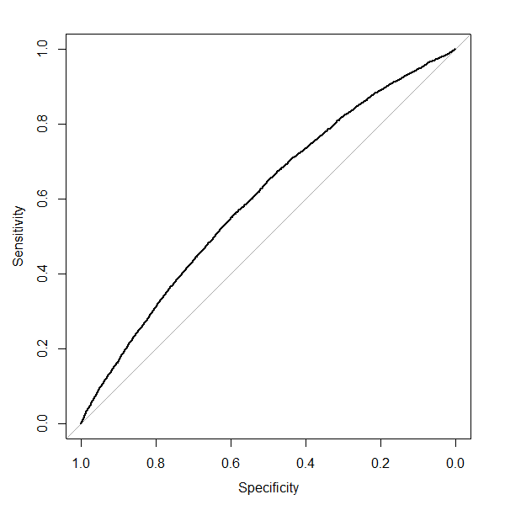
Result & Interpretation
Donation prediction
AUC | 0.6013304
F1 score | 0.1249
Lift | 1.4896
 |  | Predicted
 |  | 0 | 1
Actual | 0 | 69594 | 21900
 | 1 | 3089 | 1784
AUC: 0.6013304

Slide 15

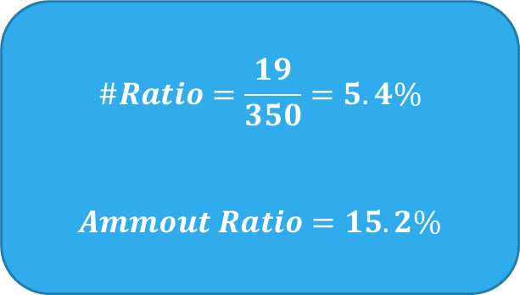
Result & Interpretation
Top 350 prediction
Custom ID | Donation | AmDonated
No.185147 | 1 | 500
No.185056 | 2 | 250
No.4006 | 4 | 200
No.12595 | 6 | 200
No.185094 | 7 | 112
No.8391 | 8 | 100
No.12333 | 11 | 100
No.5720 | 12 | 100
No.5050 | 13 | 100
No.11835 | 15 | 100
No.12592 | 17 | 100
No.137965 | 19 | 100
No.4206 | 21 | 100
No.8844 | 26 | 100
No.5660 | 30 | 100
No.14463 | 42 | 55
No.12367 | 73 | 50
No.6136 | 84 | 50
No.12284 | 109 | 50
$$\#Ratio=\frac{19}{350}=5.4\%$$
$$Ammout Ratio=15.2\%$$

Slide 16

Interpretation
Selected features with coefficients of Lasso Model
Customer Information
City Low | -0.0545
Rural Average | -0.0757
Suburban Average | 0.1177
Suburban Low | -0.0978
Town Average | 0.0510
Town Low | -0.1520
Urban Average | -0.0912
Urban Below Average | -0.0285
Urban Low | -0.0265
Age | -0.0193
NumberOfChild | -0.0421
Income | 0.0686
GenderJ | 0.2939
Census Information of Neighborhood
PercEmpState | 0.0120 | IC3H | -0.0080
PercEmpFed | -0.0154 | IC6H | 0.0104
Persons | -0.0105 | IC7H | -0.0239
PercMale | 0.0172 | IC2F | 0.0046
PercWhite | 0.0023 | IC5F | 0.0005
PercBlack | -0.0270 | LFAM | 0.0246
PercAsianInd | -0.0013 | PercManage | -0.0234
PercChin | -0.0271 | PercCler | -0.0050
PercPhil | -0.0084 | PercFarm | 0.0258
PercKor | 0.0160 | PercTran | 0.0084
PercViet | -0.0031 | PercLab | -0.0040
PercHaw | 0.0023 | EMP2 | 0.0023
AgeC3 | 0.0066 | EMP6 | -0.0136
AgeC6 | 0.0091 | EMP7 | -0.0219
ChildC1 | 0.0007 | EMP8 | 0.0019
ChildC2 | 0.0157 | EMP10 | -0.0075
PercElder | 0.0511 | EMP11 | -0.0070
PercSepDiv | 0.0117 | EMP13 | -0.0183
PercSingle | -0.0297 | MedEdu | -0.0291
AvgHomeVal | 0.1019 | Edu1 | -0.0140
PercStateBr | -0.0418 | Edu3 | -0.0382
LangOth | -0.0178 | Edu5 | 0.0275
 |  | Edu6 | 0.0014
Donation History
LifeGiftNum | 0.0264
LifeGiftPromNum | 0.1519
MinDol | -0.0221
LastDol | -0.2246
AvgDol | -0.0154
MonthOfFirstGift | -0.0060
Notes:
Coefficient

Slide 17
Market recommendation
Personal financial status plays an important role of donation.
(Income, Settlement type, Social Status)
Focus on middle class within each settlement type.
Pay more attention on frequency and amount of donation of individual.
Individual information is more important than neighborhood census.
(Education, Profession, Working load, Household ,Income, Marriage, …etc.)

Slide 18
Future Improvement
Feature Engineering
Ensemble Lasso & Random Forest & Gradient Boosting, etc.
e.g. convert zip code into continuous variable via leave-one-out encoding

Slide 19
Q & A

